Slide 1
Simple Review
Order Statistics
  Expected linear time selection
    Main idea: PARTITION
    Worst-case Θ(n²)
  Worst-case linear time selection
    Generate a good pivot recursively.
ALS

Slide 2
Design and Analysis of Algorithms
Dynamic Programming(Ch15)
Part 1

Slide 3
Design and Analysis of Algorithms
Dynamic Programming
Topics:
Dynamic Programming (DP) paradigm
Assembly-Line Scheduling
Matrix-Chain Multiplication

Slide 4
Optimization Problems
A design technique, like divide-and-conquer.
Works bottom-up rather than top-down.
Useful for optimization problems.
Four-step method:
1. Characterize the structure of the optimal solution.
2. Recursively define the value of the optimal solution.
3. Compute the value of the solution in a bottom-up fashion.
4. Construct the optimal solution using the computed information.

Slide 5
Manufacturing Problem
Assembly-Line Scheduling
  Two parallel assembly lines in a factory, lines 1 and 2
  Each line has n stations S_{i,1}…S_{i,n} , i =1, 2
  For each j, S_{1, j} does the same thing as S_{2, j} , but it may take a different amount of assembly time a_{i, j}
  Transferring away from line i after stage j costs t_{i, j} , i=1, 2 and j =1, 2, … , n-1
  Also entry time e_{i} and exit time x_{i} at beginning and end

Slide 6
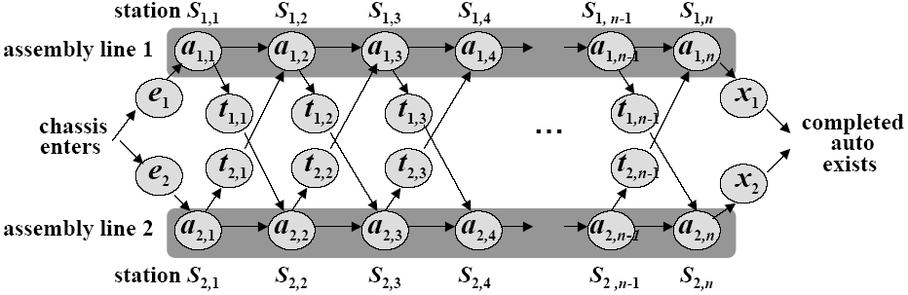
Assembly Lines
  n stations on each line: S_{1,1}…S_{1,n} and S_{2,1}…S_{2,n} .
  a_{i, j} : time required on line i at station j.
  Transferring times: t_{i, j} .
  Entry and exit time: e₁ , e₂ , x₁ , x₂.
  Goal: Find the fastest path through the factory.
  (Trying all possibilities is not tractable.)

Slide 7
Assembly Lines
Properties of the optimal solution: consider the fastest way of exiting station S_{1,j}.
  if j = 1, then there’s only one way,
  if j ≥ 2, then in order to exit station j, we must have
    1. either gone through station S_{1,j-1}, or
    2. gone through station S_{2,j-1} and transferred to S_{1,j}.
  In the first case, we must have used the fastest way of exiting S_{1,j-1}.
  In the second case, we must have used the fastest way of exiting S_{2,j-1}.

Slide 8
Assembly Lines
Key observation. An optimal solution to the problem (fastest way through S_{1,j}) contains within it an optimal solution to subproblems (fastest way through S_{1,j-1} or S_{2,j-1}). [Optimal substructure]
It’s easy to write a recursive solution to the problem now.

Slide 9


Recursive Formula
Let f_{i}[j] denote the fastest possible time (which is the values of optimal solution, optimal substructure) to get the chassis through S_{i,j}
Have the following formulas:
Using symmetric reasoning, we can get the fastest way through station S_{2,j}
Total time:

Slide 10
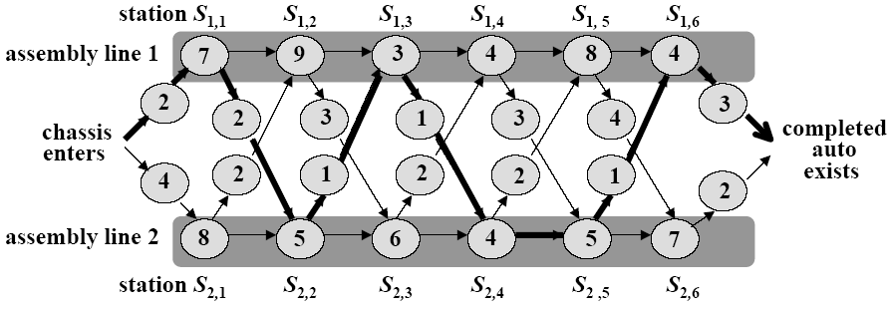
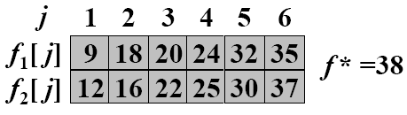
A better computation
We can do much better if we compute the f_{i}[j] values in a different order from the recursive way.
-- By computing the f_{i}[j] values in order of increasing station numbers j – left to right in Fig. 15.2(b)

Slide 11
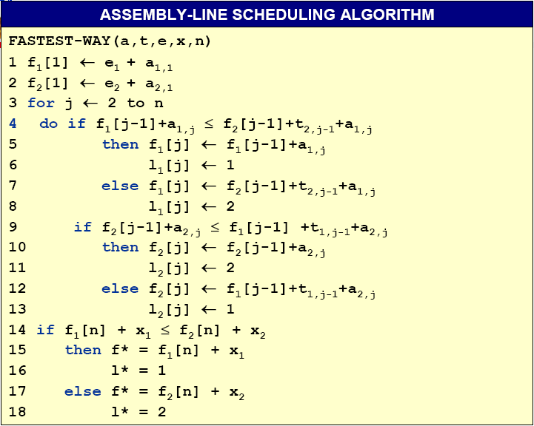
l_{i}[j]: keep track of how to construct an optimal solution
A better computation
-- Define l_{i}[j] to be the line number 1 or 2, whose station j–1 is used in a fastest way through station S_{i,j}, for i = 1, 2 and j = 2,3,…,n
--Define l* to be the line whose station n is used in a fastest way through the entire factory.
Θ(n)

Slide 12
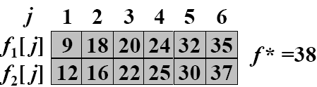
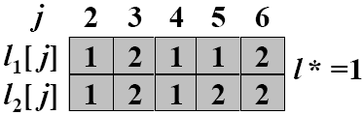
Construct an optimal solution
Can we avoid some computations?

Slide 13
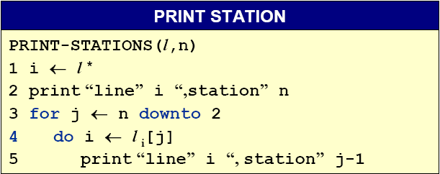
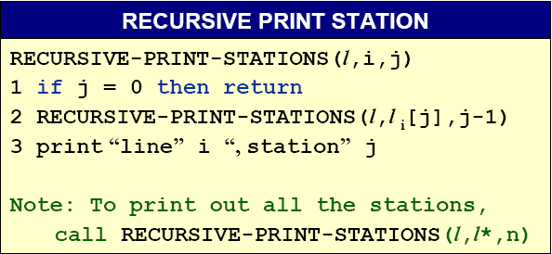
Constructing the fastest way
In the example described above, PRINT-STATIONS would produce the output
line 1, station 6
line 2, station 5
line 2, station 4
line 1, station 3
line 2, station 2
line 1, station 1

Slide 14
Matrix-chain multiplication
Goal. Given a sequence of matrices A₁,A₂,…,A_{n}, find an optimal order of multiplication.
Multiplying two matrices of dimension p×q and q×r, takes time which is dominated by the number of scalar multiplication, which is pqr.
Generally. A_{i} has dimension p_{i-1}×p_{i} and we’d like to minimize the total number of scalar multiplications.
Notes:
Scalar：数量,标量

Slide 15

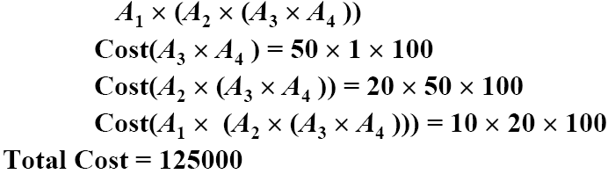
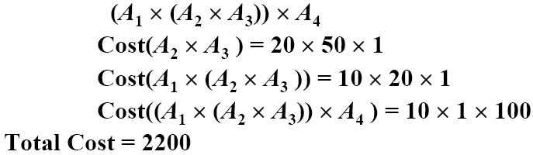
Example
Order 1
Order 2

Slide 16
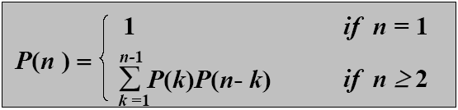

Brute force method
What if we check all possible ways of multiplying? How many ways of parenthesizing are there?
P(n): number of way of parenthesizing. Then P(1) =1 and for n≥2
Fact
These numbers are called Catalan numbers. There are about 65 combinatorial interpretations in Stanley, Enumerative Combinatorics, Vol. 2
Notes:
Enumerative Combinatorics ：《计数组合学》

Slide 17
Optimal substructure
Notation. A_{i..j} represents A_{i}…A_{j}.
Any parenthesization of A_{i..j} where i < j must split into two products of the form A_{i..k} and A_{k+1..j}.
Optimal substructure. If the optimal parenthesization splits the product as A_{i..k} and A_{k+1..j}, then parenthesizations within A_{i..k} and A_{k+1..j} must each be optimal.
--We apply cut-and-paste argument to prove the optimal substructure property.

Slide 18
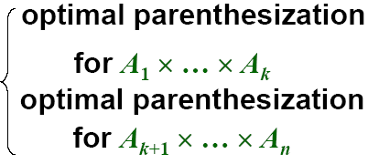
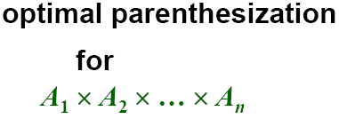
An optimal parenthesization’s structure
If the optimal parenthesization of A₁ * A₂ * … * A_{n} is split between A_{k} and A_{k+1}, then
The only uncertainty is the value of k
--Try all possible values of k. The one that returns the minimum is the right choice.

Slide 19
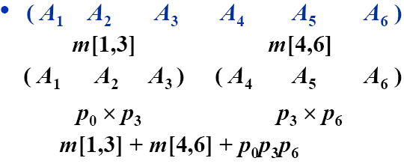
A recursive solution
Define m[i,j] as the minimum number of scalar multiplications needed to compute the matrix product A_{i..j} (We want the value of m[1,n].)
--If i = j, there is nothing to do, so that m[i,j] = 0;
--Otherwise, suppose that the optimal parenthesization split the product as A_{i..k} and A_{k+1..j}.

Slide 20
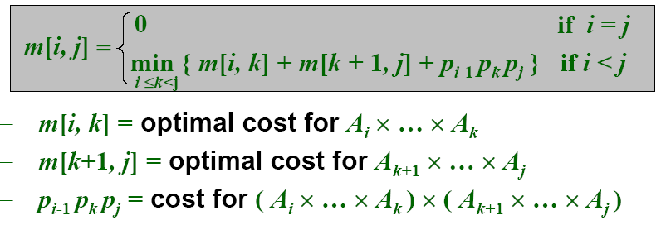
A recursive formulation
We would like to find the split that uses the minimum number of multiplications. Thus,
To obtain the actual parenthesization, keep track of the optimal k for each pair (i,j) as s[i,j].

Slide 21

Computing the Optimal Costs
--The recursive solution takes exponential time. (Easy proof by induction.)
1 | 2 | 3 | 4 | 5 | 6
0 |  |  |  |  |  | 1
 | 0 |  |  |  |  | 2
 |  | 0 |  |  |  | 3
 |  |  | 0 |  |  | 4
 |  |  |  | 0 |  | 5
 |  |  |  |  | 0 | 6
Instead, use a dynamic program to fill in a table m[i,j]:
--Start by setting m[i,i]=0 for i = 1,…,n.
--Then compute m[1,2], m[2,3],…,m[n-1,n].
--Then m[1,3], m[2,4],…,m[n-2,n],…
--… so on till we can compute m[1,n].
The input a sequence p=<p₀,p₁,…,p_{n}>, we use an auxiliary table s[1..n,1..n] that records which index of k achieved the optimal cost in computing m[i,j].

Slide 22
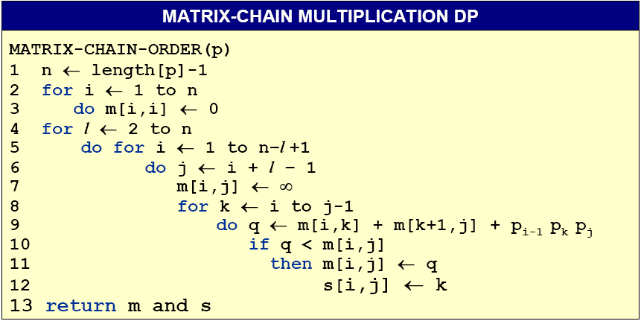
Matrix-Chain Multiplication DP Algo.
O(n³)

Slide 23
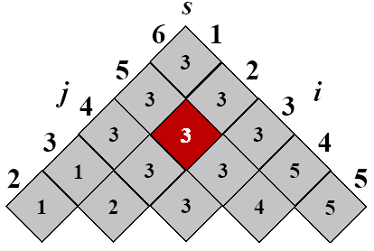
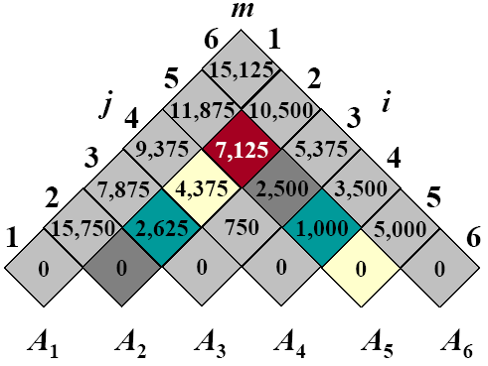
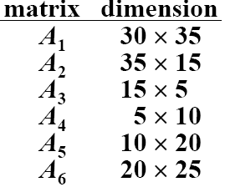
Example: DP for CMM
The optimal solution is ((A₁(A₂A₃))((A₄A₅)A₆)
Notes:
m[2,5]
m[2,2] + m[3,5] + 35*15*20 = 0 + 2500 + 10500 = 13000
m[2,3] + m[4,5] + 35*5*20 = 2625 + 1000 + 3500 = 7125
m[2,4] + m[5,5] + 35*10*20 = 4375 + 0 + 7000 = 11375

Slide 24
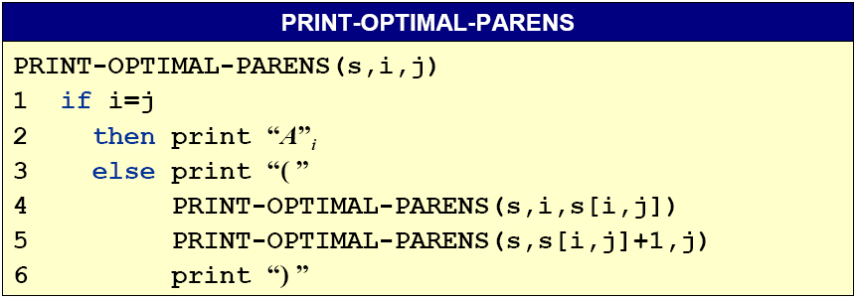
Construct an Optimal Solution
The final matrix multiplication in computing A_{1..n} optimally is A_{1..s[1,n]}A_{s[1,n]+1..n}. s[1,s[1,n]] determines the last matrix multiplication in computing A_{1..s[1,n]} and s[s[1,n]+1,n] determines the last matrix multiplication in computing A_{s[1,n]+1..n}.

Slide 25
Homework
15.1-1, 15.2-1

